Slide 1
PEL Alternative Workshop
December 2021

Slide 2
US-20; Ashton to SH-87 Jct. PEL Alternative Workshop
Welcome
Thank you for coming and being a part of this process.
Notes:
As stakeholders, you are part of the planning process. All of you come to the table with different perspectives and we want you to share those perspectives with us, and the other members of your group tonight. We also ask you to consider opinions that might differ from yours and stay open-minded. We believe that by working together, and considering a wide-range of perspectives, we can develop solutions that benefit ALL users of US-20.
Today is a time to work with you as stakeholders and to come together and listen to your ideas.

Slide 3
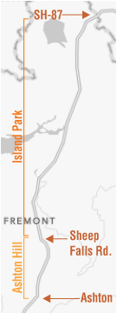
Project Overview
US-20; Ashton to SH-87 Jct. PEL Alternative Workshop
Project Extent: US-20; Ashton to SH-87 Jct.
FHWA Website: https://www.environment.fhwa.dot.gov/nepa/nepa_projDev.aspx
Project Website:
https://itdprojects.org/projects/us-20-ashton-to-sh-87-jct/
Notes:
Due to increasing traffic causing congestion and crashes, improvements are needed to maintain a safe roadway and reliable connection to adjacent communities.
ITD is conducting a Planning and Environmental Linkages (PEL) process to look at ways to improve US-20. The PEL is essentially a planning process that helps ITD develop, refine, and screen potential alternatives. The PEL will help ITD go into the National Environmental Policy Act (or NEPA) process in a better position to complete an Environmental Evaluation because alternatives will already have been developed and screened. That means instead of 100 alternatives, ITD can focus on one or two that are feasible. Public involvement is an important part of both the PEL and the NEPA process.
We presented a description of the PEL process at the public involvement meetings held in October. If you are curious or want more detailed information about the PEL and NEPA processes, we would be happy to discuss it further with you or you can go to the Federal Highway Administration website. https://www.environment.fhwa.dot.gov/nepa/nepa_projDev.aspx .

Slide 4
Purpose of
the Workshop
US-20; Ashton to SH-87 Jct. PEL Alternative Workshop
We will:
Summarize what we have heard.
Provide additional information.
You will:
Identify potential solutions that should be considered.
We have provided paper maps of different scales to help you as you explain your ideas as well as document those thoughts and ideas as you describe them.
Notes:
At each of your tables there are maps of US-20. We want you to use those maps to identify potential solutions we should consider.
Facilitators will help record your ideas and will help keep the conversation flowing but, each of YOU are responsible for what is developed at your table. Please share your best ideas to help contribute to the conversation.
We also have subject matter experts here who are available to answer technical questions.

Slide 5
US-20; Ashton to SH-87 Jct. PEL Alternative Workshop
What we have heard so far
To Date:
Total of 80 comments received.
Seven (7) comments submitted at Oct. 12 meeting.
15 comments submitted at Oct. 13 meeting.
29 comments submitted through the online meeting.
29 submitted through the project email.
Notes:
Before we get started, we would like to share with you some of the topics and comments we have heard thus far. A summary of comments received has been posted on the project website and was also sent out December 1st on constant contact email. Some of the general topics that have come up include:

Slide 6
US-20; Ashton to SH-87 Jct. PEL Alternative Workshop
What we have heard so far
Will access to US-20 change along the corridor? (19 comments relating to access)
Specific area of concern several have mentioned is the Ashton Hill Estates area. (14 comments relating to access)
Notes:
From the comments that we have gathered, there were 19 comments relating to access:
While it's too early in the process to know if access might change, depending on the alternatives developed, access management could be needed to limit and separate conflict points on the highway.
Access management is vital to protect and maintain the public’s safety and welfare and meet the needs for the traveling public
There were 5 general comments concerning access. There was one specific location where there were several comments. There were 14 comments on Ashton Hill:
The goal of the alternative development is to improve safety on US-20. With that in mind, ITD will look at alternatives that include design features that improve safety for those who access homes near Ashton Hill.

Slide 7
US-20; Ashton to SH-87 Jct. PEL Alternative Workshop
What we have heard so far
Purpose and need of the project. (15 comments)
Freight is a concern. (15 comments relating to access)
Notes:
The PEL purpose and need as well as freight were also common concerns.
Developing the Draft Purpose and Need is an important part of the PEL process. Your input will help to shape the purpose and need of this process.
According to the Federal Highway Administration (FHWA), virtually everything manufactured, bought, or consumed in the United States at some point is transported by truck. ITD does not have the authority to restrict trucks from US-20. US-20 is a Federal Highway that provides services for many different users. Alternatives developed as part of the PEL process will look at ways to provide a safe roadway for all travelers.

Slide 8
US-20; Ashton to SH-87 Jct. PEL Alternative Workshop
What we have heard so far
Thoughts and ideas relating to design:
Realignment of US-20 near Ashton. (10)
Suggestions for new alignments. (5)
Potential four lane roadway. (18)
Adding passing lanes and turn lanes. ( 9 )
Notes:
Realignment of US-20 near Ashton. (10) A range of alternatives will be considered as part of the US-20 Ashton to SH-87 JCT PEL. It is possible that alternatives will include routes that have potential realignment around Ashton.
New alignment suggestions. (5) There were also comments on suggestions for other alignment changes.
Potential four lane roadway. (18) Adding passing lanes and turn lanes ( 9 ) ITD will develop a wide range of alternatives to improve safety on US-20. Some of the alternatives may include different lane configurations than what currently exists on the highway. Today is another opportunity to give input and contribute to the range of alternatives developed.

Slide 9
US-20; Ashton to SH-87 Jct. PEL Alternative Workshop
What we have heard so far
Thoughts and ideas relating to coordination:
Coordination with elected officials, Fremont County Commissioners, Resource Agencies and the public. (28)
Notes:
Many expressed their desire that there be coordination with elected officials and other resource agencies.
ITD has already begun to engage a wide range of stakeholders interested in this corridor to determine how the corridor can be improved to best serve all users. We have met with the County Commissioners as well as several resource agencies with interest in this corridor.
Public input will be an important part of the decision-making process and will be balanced with technical information and engineering best-practices. Project decisions will incorporate a data-driven process, meaning the team will include scientific data to develop and screen alternatives.

Slide 10
US-20; Ashton to SH-87 Jct. PEL Alternative Workshop
What we have heard so far
Thoughts and ideas relating to wildlife safety/collisions (46):
Mostly concerned with protecting wildlife and reducing crashes.
Three comments were opposed to wildlife overpasses.
Notes:
There were many comments from the public concerning wildlife, safety and collisions.
ITD has met with Idaho Fish and Game, US Forest Service, and US Fish and Wildlife Services that also have concerns about wildlife, safety, and collisions. Several different animals live and migrate through this area along US-20.
ITD will continue to coordinate with Idaho Fish and Game for guidance about wildlife along the corridor.
At the first public meeting, it was requested that we show more information that the Idaho Fish and Game had about deer and elk migration across US-20. The Idaho Fish and Game staff has put together the following informational video about the wildlife telemetry data.

Slide 11
IDFG: Deer and Elk
US-20; Ashton to SH-87 Jct. PEL Alternative Workshop
Notes:
ITD and the project team has already begun to meet regularly with IDFG personnel about this project. The Idaho Fish and Game will continue to be a part of the PEL process.

Slide 12
Notes:
As a team, we will continue to focus on the trends and opportunities to improve safety. The exhibit shown here is a depiction of the crashes by severity type that we showed at the first public meeting for this project. As alternatives are evaluated for safety, we will consider all factors contributing to the crashes along the corridor.

Slide 13
Notes:
This Traffic Data exhibit was also shown at the first public meetings as well. Traffic volume increases seen throughout the years will be used to help make decisions about capacity needs for the roadway in the future.

Slide 14
US-20; Ashton to SH-87 Jct. PEL Alternative Workshop
What we have heard so far
Thoughts and ideas relating to roadway maintenance and operations:
Roadside tree removal. (5)
Improved signage. (5)
Enforcement. (9)
Speed. (9)
Notes:
We have received several comments relating to maintenance and roadway operations. General categories of these comments included roadside tree removal, improved signage, law enforcement and speed. These comments are valued and will be conveyed to maintenance crews, Idaho State Police and Fremont County.
These items are generally outside the discussion about the project and environmental concerns and can be addressed separately.

Slide 15
“Parking Lot” items
US-20; Ashton to SH-87 Jct. PEL Alternative Workshop
The purpose of this workshop is to have you identify potential solutions that should be considered.
We ask that everyone be respectful of others thoughts and ideas.
Notes:
As the discussions at the tables happens tonight there may be questions, topics or comments that need either additional time to answer or need to be set aside so the group can focus on solutions.
We are calling these items parking lot items. If time allows, we will address as many of these parking lot items at the end of the meeting. If we run out of time, or we need additional time to respond, these will be addressed in a project email update after the meetings.

Slide 16
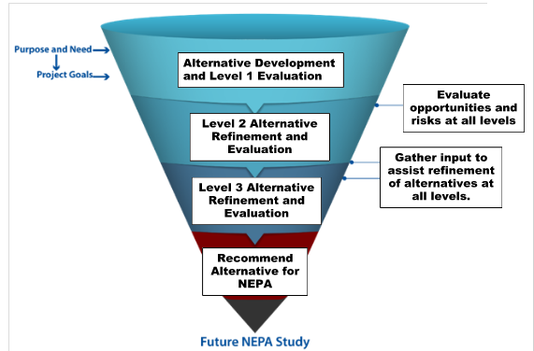
US-20; Ashton to SH-87 Jct. PEL Alternative Workshop
What is next?
Alternative development, refinement and evaluation.
Notes:
With what we gather from you today, and what we have begun considering, we will develop a wide range of alternatives. As we continue to gather information and work through the process we will screen and refine these alternatives further.
Alternatives that are less effective in meeting the purpose and need of the project will be screened out. We will screen down to fewer and fewer alternatives as the process continues.

Slide 17
Draft Screening Criteria
Criteria |  | Level 1 Criteria Question
Safety |  | Does the alternative provide opportunities to improve safety?
Mobility for all users |  | Does the alternative increase mobility? Does it reduce congestion?
Future Corridor Travel Needs |  | Will the alternative improve travel time and lessen delays for future traffic needs?
Environmental | Visual | Does the alternative create problematic or unmitigatable visual impacts?
Environmental | Agriculture and Forest Resources | Does the alternative create problematic or unmitigatable impacts to agriculture and forest resources?
Environmental | Air Quality | Does the alternative create problematic or unmitigatable air quality impacts?
Environmental | Biological Resources | Does the alternative create problematic or unmitigatable impacts to biological resources?
Environmental | Cultural Resources | Does the alternative create problematic or unmitigatable impacts to cultural resources?
Environmental | Geology and Soils | Does the alternative create problematic or unmitigatable impacts to the geology and soils?
Environmental | Hazards and Hazardous Materials | Does the alternative create problematic or unmitigatable hazards or impacts stemming from hazardous materials?
Notes:
Using the information we have collected thus far, we have begun developing the draft screening criteria by which each alternative will be evaluated. As we evaluate each alternative, we will consider:
Safety and the opportunities to improve safety
Congestion. Will the alternative reduce congestion? ____________________________________
The future corridor and travel needs. Will the alternative improve travel time and lessen delays for the traffic?
We will evaluate potential impacts and/or benefits to environmental resources along the corridor. These resources include:
Visual impacts
Agriculture and Forest Resources
Air Quality
Biological resources
Cultural Resources
Geology and Soils
Hazards and Hazardous materials.

Slide 18
Draft Screening Criteria cont.
Criteria |  | Level 1 Criteria Question
Environmental | Hydrology and Water Quality | Does the alternative create problematic or unmitigatable impacts to hydrology and water quality?
Congestion | Land Use and Transportation Planning | Does the alternative provide benefits indicated on land use and transportation plans?
Future Corridor Travel Needs | Noise | Does the alternative create problematic or unmitigatable impacts relating to noise?
Future Corridor Travel Needs | Social and Economics | Does the alternative enhance or improve economic opportunities? Does the alternative impact the social aspects of the community?
Additional Project Needs |  | Does the alternative affect any additional project needs identified?
Future Corridor Travel Needs |  | Will the alternative improve travel time and lessen delays for future traffic needs?
Notes:
Additionally, These resources include:
Hydrology and Water Quality
Land Use and Transportation Plans
Noise
Social and Economic Impacts
We will also consider any additional project needs as they arise.

Slide 19
Code of Conduct for the Workshop
US-20; Ashton to SH-87 Jct. PEL Alternative Workshop
Stay open minded - seek to understand before passing judgment.
Be respectful of other’s ideas and thoughts, even if you disagree.
Listen to understand.
Share all relevant information.
Use specific examples and agree on what important words mean.
Explain reasoning and intent.
Discuss undiscussable issues.
Understand that we probably won’t achieve all things for all people.

Slide 20
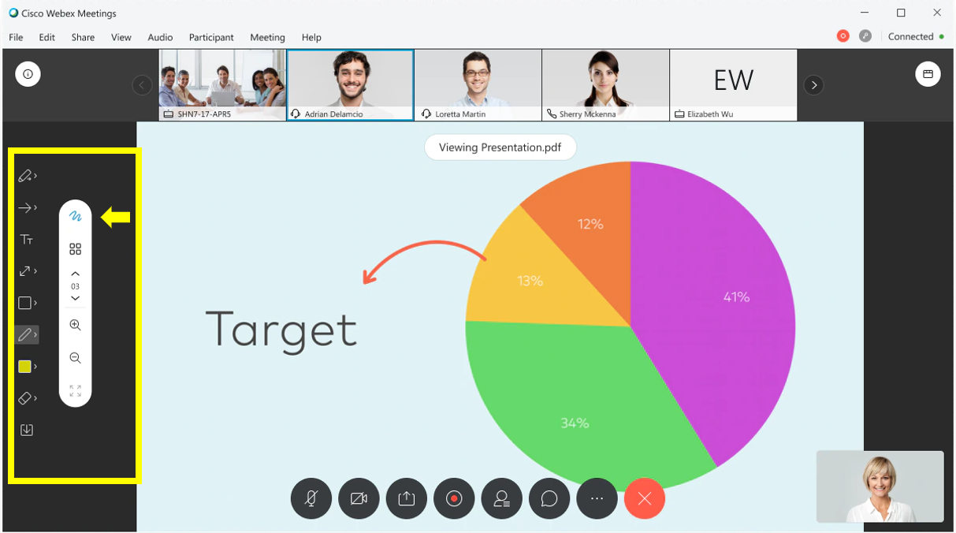
Webex Annotation Instructions
US-20; Ashton to SH-87 Jct. PEL Alternative Workshop

Slide 21
US-20; Ashton to SH-87 Jct. PEL Alternative Workshop
Use chat for: sharing thoughts, discussion with one another, general feedback.
Note: You may not receive a response to your chat from the project team, but the chat will be reviewed by the project team and saved as part of the meeting record.
If you don’t see the Chat, Q&A, or Raise Hand icons, try looking for them by clicking on this button:
Use Q&A for: asking questions that you’d like the project team to answer.
Note: Send your question to ALL CO-HOSTS. Depending on the volume of questions, we may respond as questions come in or we may reserve them for the end of the workshop as time permits (if unable to address all questions during the meeting, we’ll follow up with responses after the meeting).
Raise your hand: when you have an urgent question or comment pertinent to the idea being discussed.
Note: We will call on you as soon as possible during the meeting.
Notes:
For Online Meeting

Slide 22
Workshop Wrap-up
US-20; Ashton to SH-87 Jct. PEL Alternative Workshop
Parking Lot Items.
Next Steps.
Notes:
Discussion of Parking Lot Items
Next Steps:

Slide 23
US-20; Ashton to SH-87 Jct. PEL Alternative Workshop
Notes:
With the completion of the workshops, we will evaluate each of the proposed alternatives. Those that are selected to move forward beyond the level 1 screening will be subjected to a more in-depth level of scrutiny. With the more in-depth evaluation of the alternatives a second level of screening will be made. At this point we will come back to you and show you what has been evaluated thus far. This will be followed by a more in-depth 3rd round of screening. We will present those results to you and the PEL will then be completed. The environmental documentation NEPA process will begin following that step. If potential projects, that are common to all the alternatives moving forward, becomes apparent some projects may move forward as priority projects.
Thank you all for coming and taking part in this workshop.

